Slide 1
6B
TIMES WE LOVE

Slide 2
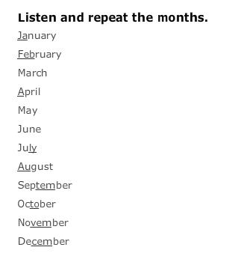


Slide 3
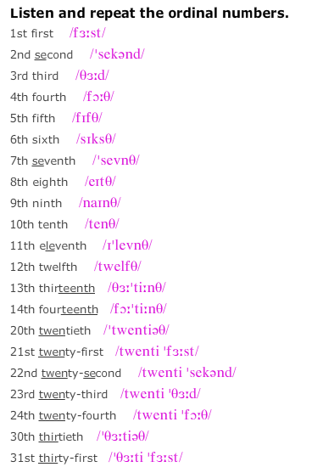
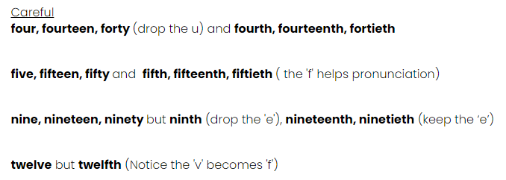

Slide 4
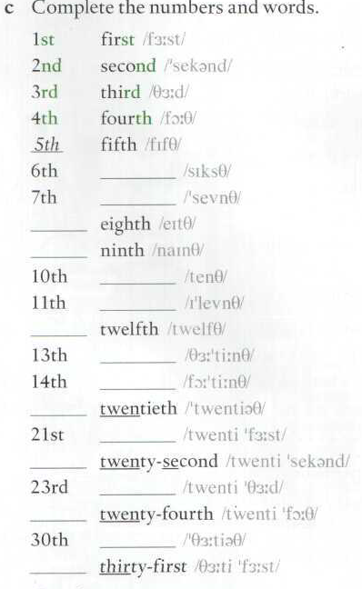
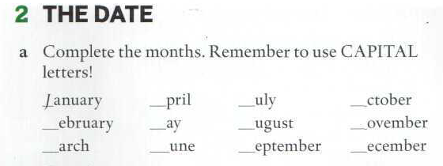
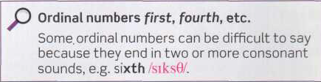
THE DATE
Page 159
sixth
seventh
8th
9th
A
J
O
F
M
A
N
tenth
M
J
S
D
eleventh
12th
thirteenth
fourteenth
20th
twenty-first
22nd
twenty-third
24th
thirtieth
31st

Slide 5
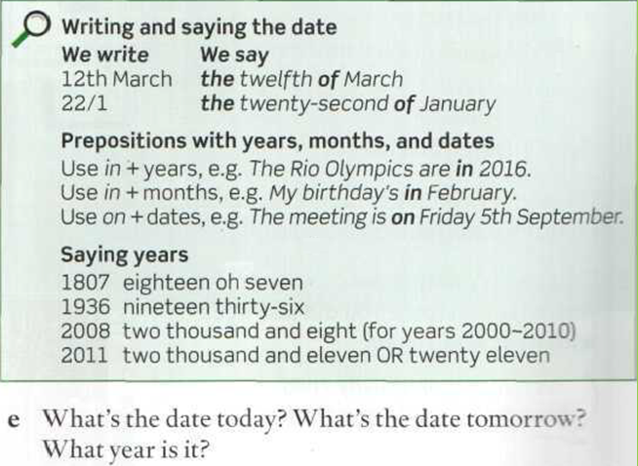
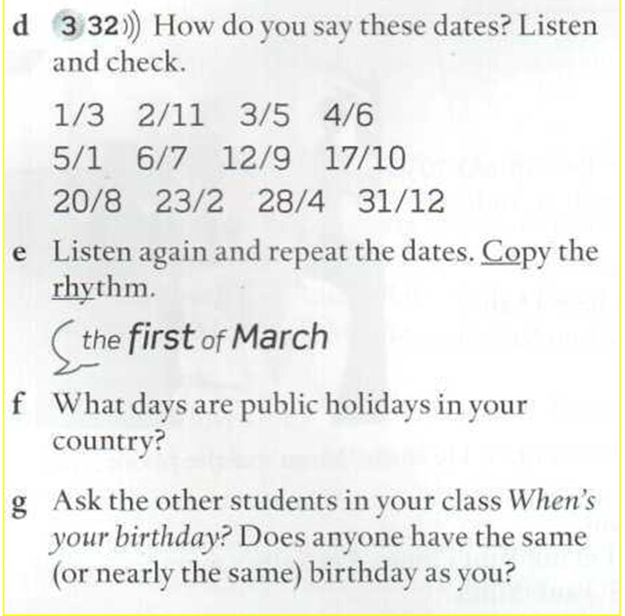
DATES
When’s your birthday?

Slide 6
Public Holidays in Argentina
1/1
15/2
16/2
24/3
2/4
1/5
25/5
20/6
9/7
17/8
12/10
20/11
8/12
25/12

Slide 7
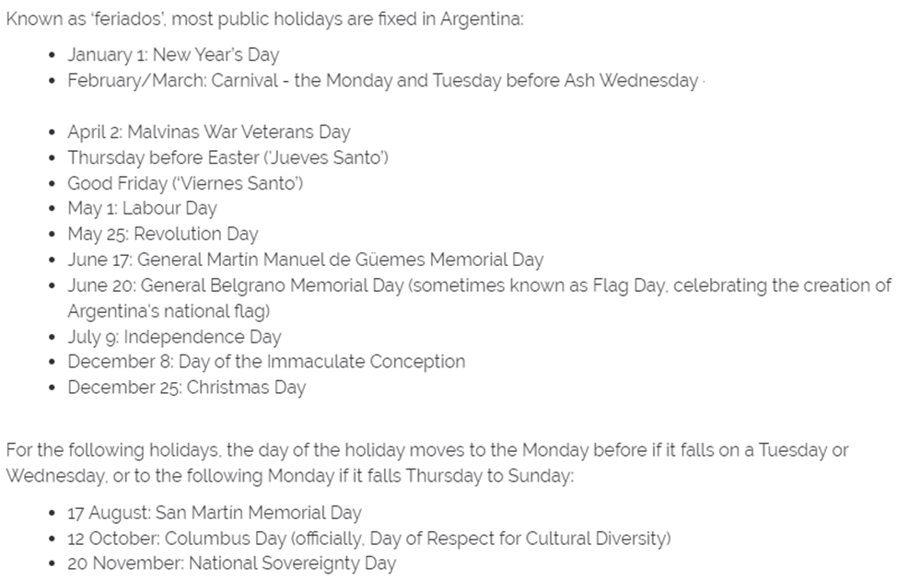

Slide 8
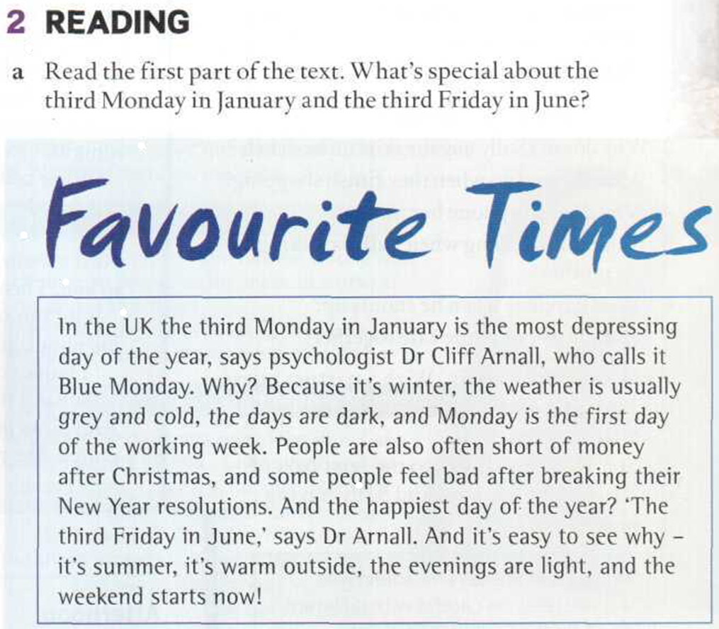
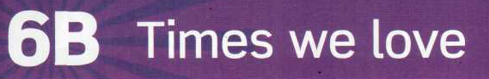

Slide 9
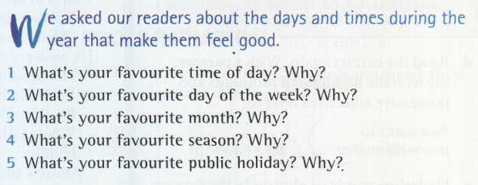
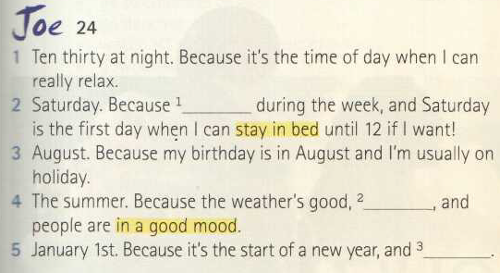
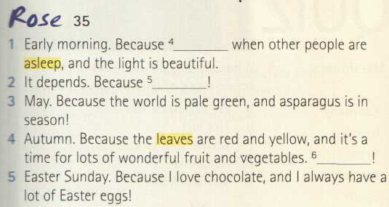
0:38
I hate getting up early
The days are long
I like being awake
I like making plans.
Every week is different
I love cooking

Slide 10
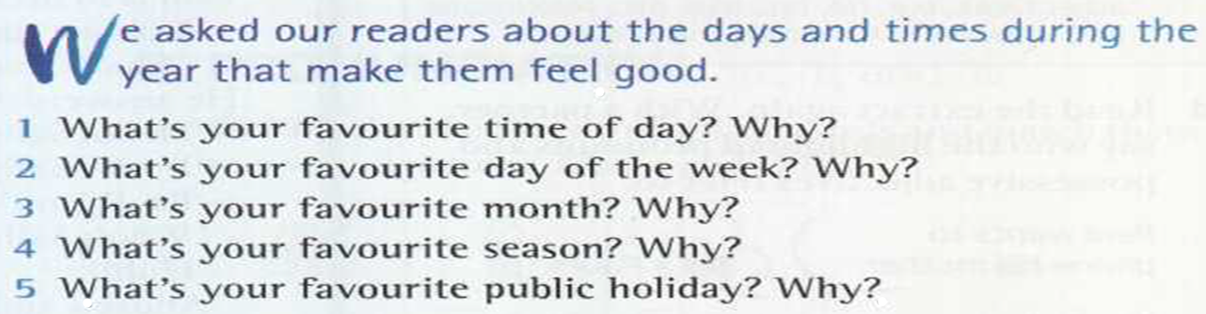
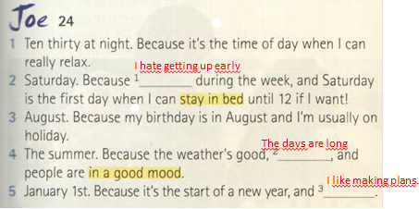
Page 47
00.52.20

Slide 11
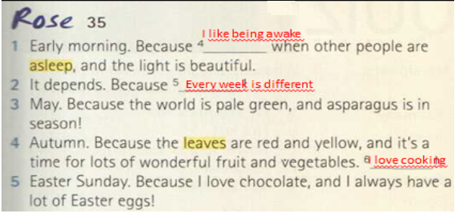
Page 47
01.41.42

Slide 12
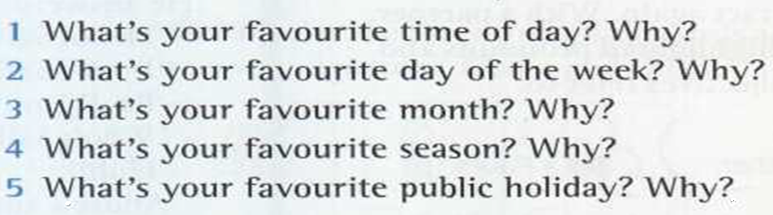
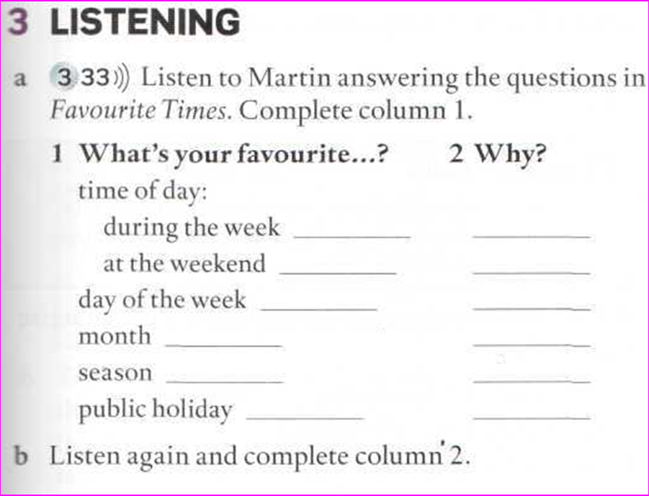
Page 47
ORAL ASSIGNMENT

Slide 13
(script in Student’s Book on p.119)
I = interviewer, M = Martin
I What’s your favourite time of day?
M It depends. During the week it’s seven in the evening, because that's when
I get home from work and when I can relax. But at the weekend my
favourite time is breakfast time. I have a big breakfast, and I have time
to read the papers and listen to the radio.
I What’s your favourite day of the week?
M My favourite day of the week is Friday, because then I know the weekend is near.
I What’s your favourite month?
M Probably May. It's when the weather starts to get warm and the evenings are long.
I What's your favourite season?
M Spring because it means that winter is finally over. I love cycling, and spring is a great time for cycling, not too hot and not too cold.
I What’s your favourite public holiday?
M Probably New Year’s Eve, because you don’t need to worry about buying presents or cooking a big lunch,
and everybody’s in a good mood.
Favourite times:
Listen to MARTIN

Slide 14
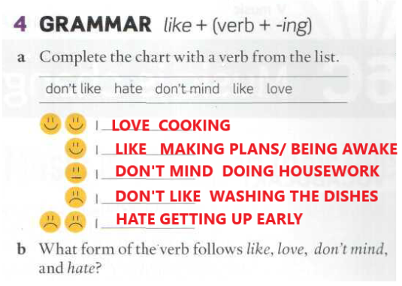

Slide 15
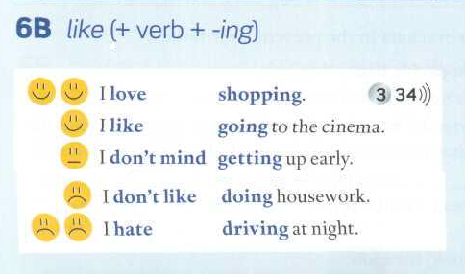

Slide 16
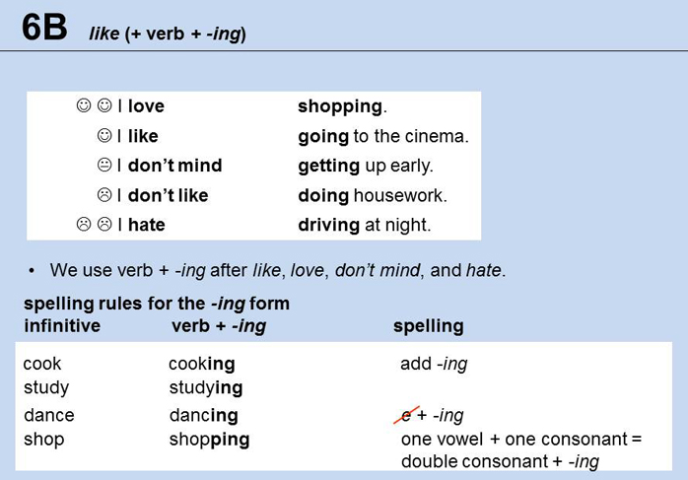

Slide 17
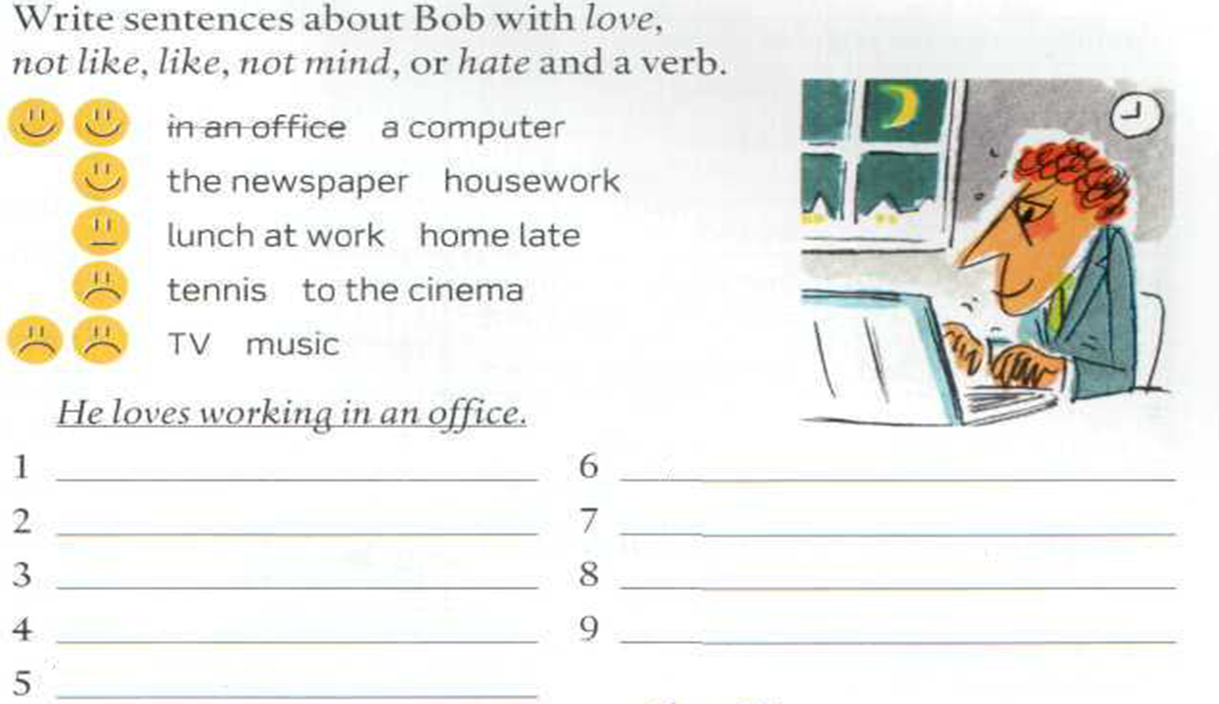
He loves using a computer.
He doesn’t like playing tennis.
He likes reading the newspaper.
He doesn’t like going to the cinema.
He likes doing housework.
He hates watching TV.
He doesn’t mind having lunch at work.
He hates listening to music.
He doesn’t mind getting home late.

Slide 18
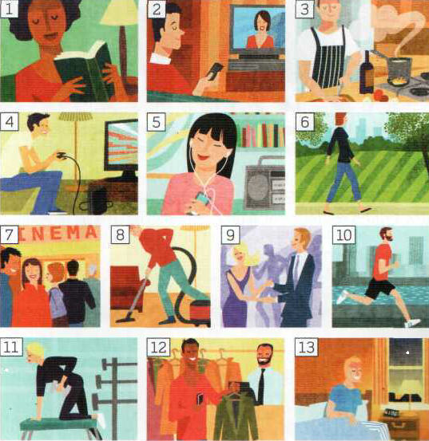
Make dialogues:
Read, watch tv, cook, play video games, listen to music, walk, go to the cinema, do housework, dance, run, do exercise, buy clothes, get up early.
-Do you like reading?
-Yes, I do. I love reading.
-Do you like doing housework?
-Mmm. I don’t mind doing housework.
-Do you like getting up early?
-No, I don’t. I hate getting up early.
Oral assignment

Slide 19
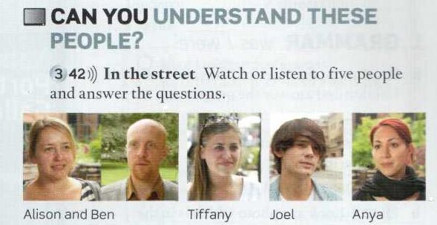
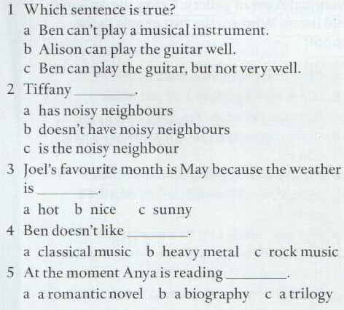
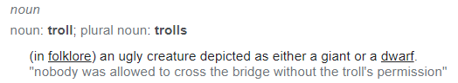

Slide 20


Slide 21
OXFORD STUDENT’S SITE
Like/hate + Verb-ing
https://elt.oup.com/student/englishfile/elementary3/grammar/file06/grammar06_b01?cc=ar&selLanguage=en
https://elt.oup.com/student/englishfile/elementary3/grammar/file06/grammar06_b02?cc=ar&selLanguage=en

